Slide 1
Thyroid Disease Detection
Submitted by: Mohammad Faiz
(A7605219061)
B.TECH CSE (8th Semester)
Under the Guidance of : Prof.(Dr.) Syed Wajahat Abbas Rizvi
Department of Computer Science & Engineering
Amity University, Lucknow Campus

Slide 2
Table Of Content
Introduction
Motivation Behind the Project
Methodology Adapted
Dataset Used
Technologies Used
Data Preprocessing
Data Visualization
Handling the Missing Data
ML Model Used
Model Evalution
Result and Discussion
Performing Predictions
Conclusion

Slide 3
Introduction
Thyroid disease detection using machine learning is a powerful approach that utilizes algorithms to analyze patient data and predict the likelihood of thyroid disorders. By training on historical records and diagnostic results, ML models can identify patterns and assist in early detection, accurate diagnosis, and personalized treatment plans. Benefits include early intervention, improved accuracy, personalized medicine, and efficient triage. Challenges include data quality, interpretability, and generalization. Despite these challenges, ML-based approaches have the potential to enhance thyroid disease detection, optimize healthcare resources, and improve patient outcomes. Further research and collaboration between medical experts and data scientists are essential for progress in this field.

Slide 4
Motivation Behind the Project
The motivation behind utilizing machine learning for thyroid disease detection arises from several factors that aim to enhance patient care, improve diagnostic accuracy, and streamline healthcare processes.
1. Improved Diagnostic Accuracy: Thyroid diseases can manifest in various ways, making their diagnosis challenging. Machine learning algorithms can analyze large volumes of patient data, including clinical records, laboratory test results, and imaging findings, to identify complex patterns and correlations that may not be easily recognizable to human experts. By leveraging these patterns, machine learning models can provide more accurate and reliable predictions, reducing the chances of misdiagnosis and ensuring appropriate treatment plans.
2. Early Detection and Intervention: Early detection of thyroid diseases is crucial for timely intervention, as it can prevent disease progression and improve patient outcomes. Machine learning algorithms can identify subtle indicators and risk factors associated with thyroid dysfunction, allowing for early detection and intervention. By identifying high-risk individuals or detecting the early stages of thyroid disease, interventions can be initiated promptly, leading to more effective treatment strategies and improved patient prognosis.

Slide 5
Motivation Behind the Project
3. Personalized Treatment Plans: Thyroid diseases exhibit significant variations in their presentation, severity, and response to treatment among different individuals. Machine learning models can analyze patient-specific data, such as demographics, medical history, genetic information, and lifestyle factors, to generate personalized treatment plans. This personalized approach considers individual characteristics and can optimize treatment outcomes by tailoring interventions to specific patient needs.
4. Resource Optimization: Healthcare resources, including diagnostic tests, specialist consultations, and medical personnel, are often limited. Machine learning algorithms can assist in the efficient allocation of these resources by triaging patients based on their likelihood of having thyroid disease. This helps prioritize patients who require further evaluation, reducing unnecessary tests and streamlining healthcare processes.
5. Research and Insights: Machine learning techniques can uncover hidden patterns and relationships within thyroid disease data, leading to novel insights and research opportunities. By analyzing large datasets, machine learning models can identify potential risk factors, elucidate disease mechanisms, and contribute to a deeper understanding of thyroid diseases. These insights can inform future research, facilitate the development of new diagnostic tools and treatment approaches, and advance our knowledge in the field.

Slide 6
Methodology Adopted
The following operations are included in the face mask detection model that has been proposed:
Data Collection
Data Analysis & Pre-processing
Handling the Missing Data
Outliers Removal
Label Encoding
Prediction Model Construction
Model Evaluation
Performing Predictions

Slide 7
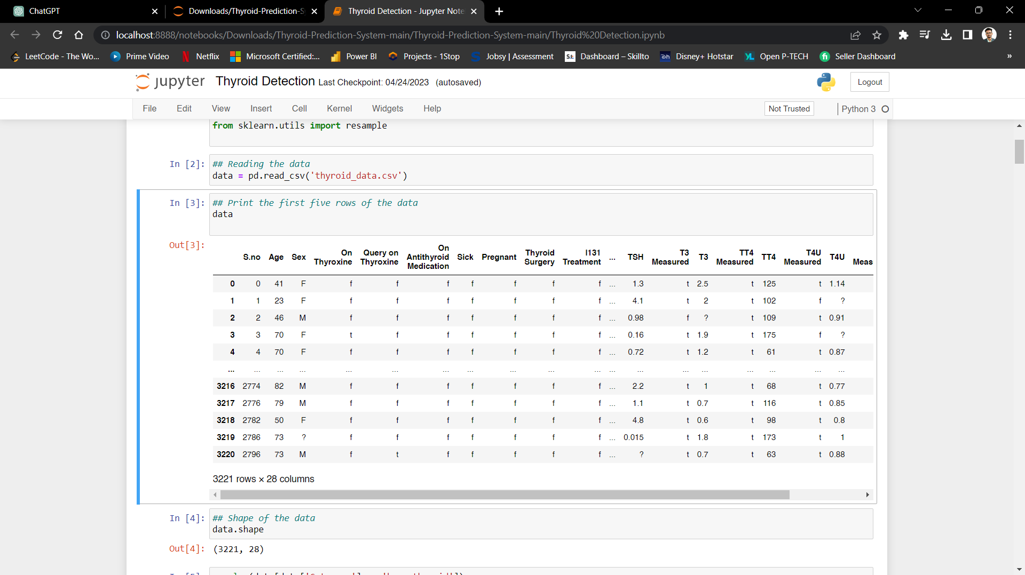
Dataset Used
The dataset provided contains various attributes related to thyroid-related conditions. The attributes include a serial number (S.no), age, sex, whether the individual is on thyroxine medication, if there are any queries regarding thyroxine, whether the person is taking antithyroid medication, if they are sick, pregnant, or have undergone thyroid surgery or I131 treatment. Other attributes include queries about hypothyroidism and hyperthyroidism, the use of lithium, presence of goitre or tumor, hypopituitarism, and psychiatric conditions. The dataset also includes measurements of TSH, T3, TT4, T4U, and FTI, along with their corresponding values. Finally, the dataset is categorized based on the information provided.

Slide 8
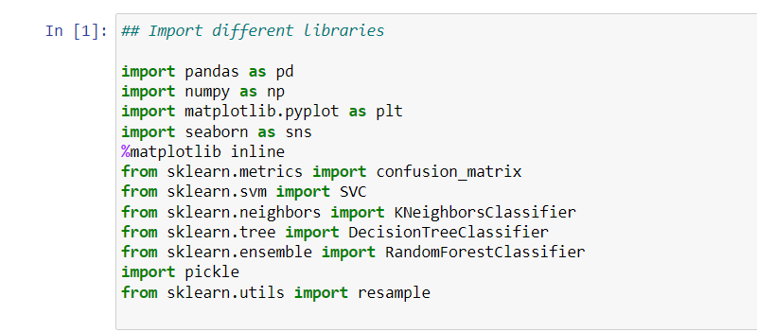
Technologies Used
To start with the project, it is necessary to first install and import a few python libraries that are essential for this project. The important libraries that are to be imported are listed in the figure below:
Fig.4. Important Python Libraries Installed

Slide 9
Data Preprocessing
Data preprocessing plays a crucial role in the thyroid disease detection using machine learning. It involves cleaning and transforming the raw dataset into a suitable format for the machine learning algorithm.
The first step is handling missing data. Missing values can be filled using techniques like mean, median, or mode imputation, or alternatively, the rows or columns with missing values can be removed.
Next, categorical variables like sex or medication usage need to be encoded into numerical values. This can be done using techniques such as one-hot encoding or label encoding.
Feature scaling is another important step. It ensures that all features have similar ranges and prevents certain features from dominating others during model training. Common scaling techniques include standardization (mean=0, variance=1) or normalization (scaling to a specific range, e.g., 0 to 1).
Feature selection or dimensionality reduction techniques may be applied to eliminate irrelevant or redundant features, reducing computational complexity and potential overfitting.
Additionally, outlier detection and removal can help to handle extreme values that might negatively impact the model's performance.
Finally, the dataset is split into training and testing sets to evaluate the model's performance accurately. It is essential to maintain the integrity of the data during this step, ensuring that the testing set is unseen during training.
By effectively preprocessing the data, it becomes more suitable for machine learning algorithms, improving the accuracy and reliability of the thyroid disease detection model.

Slide 10
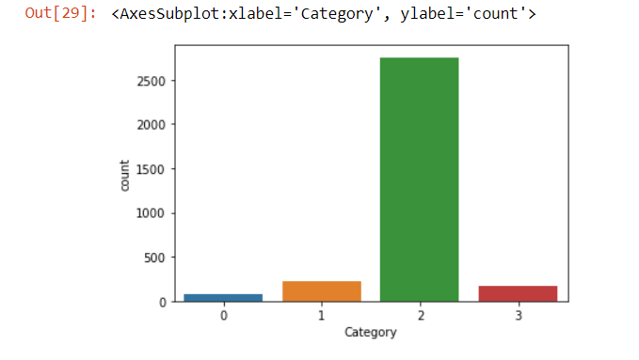
Data Visualization
After the data set collection, we proceed further to gaining insights into the structure and contents of the datasets. We used functions like head(), info(), and describe() to display the metadata regarding the dataset, including name of the columns in the set, data types, & statistical information. This step helps you understand the available features and the overall data distribution. The seaborn and matplotlib libraries provide a wide range of options for creating informative plots. We attempted to comprehend the distribution of numerous Thyroid groups in the datasets by utilizing a variety of graphical strategies. In order to see the frequency of each type, we therefore built a bar plot.

Slide 11
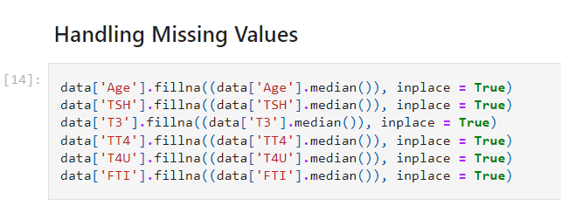
Handling the Missing Data
Missing data are entries or numbers for one or more variables in a given dataset that were not collected or were not there.
Missing numbers are a common problem in many real-world datasets.
When there are missing numbers, learning algorithms can get messed up, or the accuracy of the model can go down. To make the model work better, the average value of each attribute was used to handle missing numbers.
Figure 7. Resultant data frame after performing Data Handling.

Slide 12
ML Model Used
SVM classifier, short for Support Vector Machine classifier, is a powerful machine learning algorithm used for binary classification. It constructs a hyperplane in a high-dimensional space to separate different classes. It aims to maximize the margin between data points of different classes, making it robust to noise and capable of handling complex datasets.
KNN classifier, also known as K-Nearest Neighbors classifier, is a simple yet effective machine learning algorithm used for classification. It assigns a class label to a data point based on the majority class labels of its k nearest neighbors. KNN is non-parametric and can handle both binary and multi-class classification problems.
A decision tree is a popular machine learning algorithm used for classification and regression tasks. It builds a tree-like model of decisions and their possible outcomes based on features of the data. It splits the data based on attribute values to make predictions, making it interpretable and easy to visualize.
Random forest is an ensemble learning algorithm that combines multiple decision trees. It creates a "forest" of trees and makes predictions by aggregating the results of individual trees. Each tree is trained on a random subset of features, improving robustness, reducing overfitting, and providing accurate predictions for classification and regression tasks.

Slide 13
Model Evaluation
After being done with model training we evaluate the model accuracy. Various performance metrics are employed to analyse the model accuracy. The model accuracy can be seen in Table 1.
Algorithm | Train Score | Test Score
SVM | 61.15 | 60.37
KNN | 87.07 | 83.93
Decision Tree | 91.58 | 89.28
Random Forest | 91.58 | 89.83

Slide 14
Result and Discussion
Now we will look at the results that we obtained using various type of machine learning algorithms. Master data pre-processing and data cleaning really moved ‘?’ As it is there as a nan value. After that we have and did missing values by using median in place of missing values after this we handled nominal data then we have balance out the data which was imbalanced earlier using imblearn module.
After this we have split the data into 2 parts which is testing is off 20% and the training data is 80%.
we have compared 4 type of algorithms which are decision tree and its accuracy is 91.5% on training data set and 89.3% on testing data set, in support vector machine algorithm the accuracy is 61.11% on training dataset and 60.3% on test data set, in KNN algorithm we have obtained the accuracy of 87% on training data set and 83.9% on testing dataset, now in last algorithm which is random forest the accuracy is 91.5% on training dataset and 89.8% on testing data set.
After completing all we were developments noting that render forest algorithms accuracy was best so we will go with random forest classifier for building a web application. The F1 score for random forest classifier was 90%.
We have also done hyper parameter tuning with accuracy goes 90.03%, if we compare both hyper parameter tuning, and normal machine learning algorithm so best result is from random forest classifier so we will go with random forest classifier for web application.

Slide 15
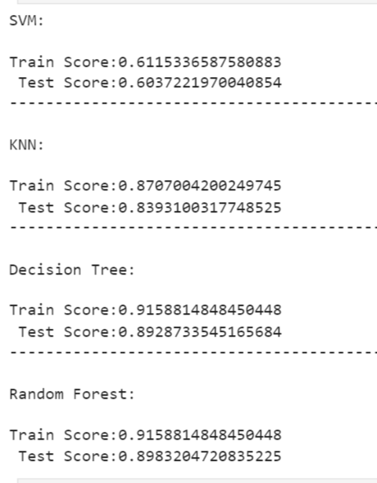
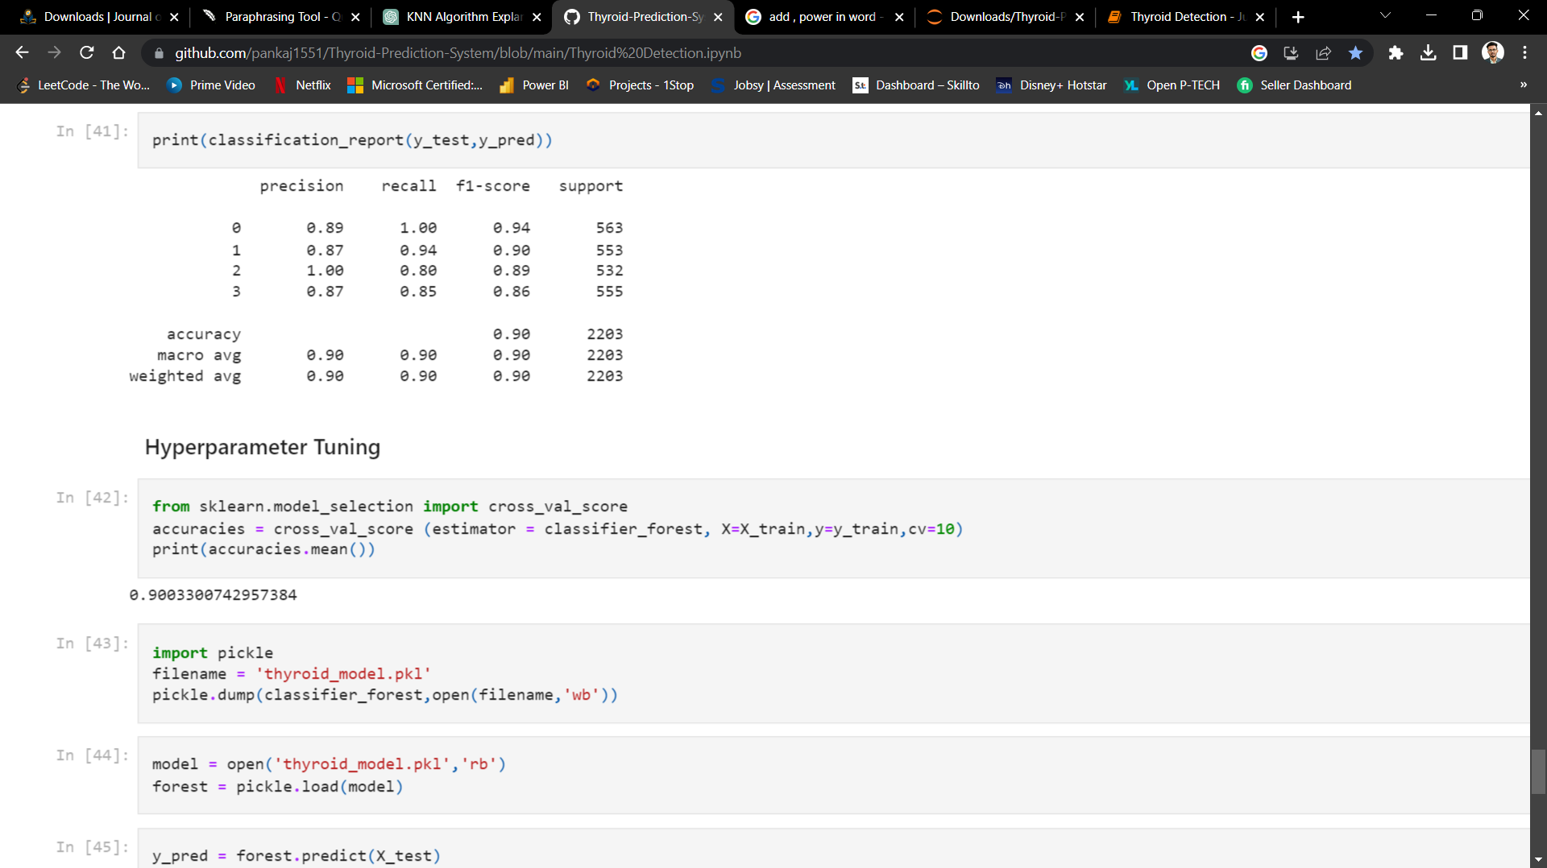
Result and Discussion
Algorithm | Train Score | Test Score
Random Forest | 0.9158 | 0.8983
Decision Tree | 0.9158 | 0.8928
SVM | 0.6115 | 0.6037
KNN | 0.8707 | 0.8393

Slide 16
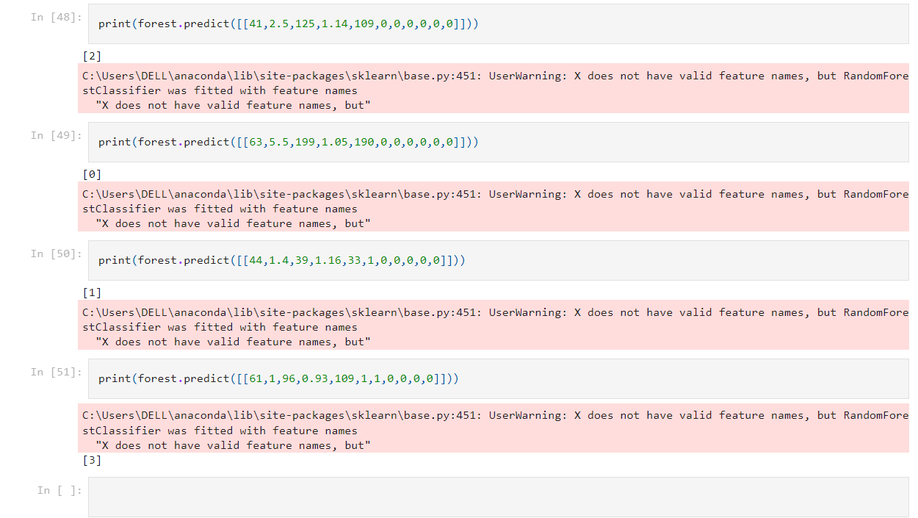
Performing Predictions

Slide 17
Conclusion
In conclusion, machine learning has shown promise in finding thyroid diseases. Algorithms like KNN, SVM, Decision Tree ad Random Forest Classifier are used to correctly classify thyroid diseases from clinical data. These algorithms could be used to help doctors make decisions and diagnose conditions, making it easier and more accurate to find thyroid illnesses.
But the success of these machine learning algorithms depends on a number of things, such as the quality and amount of data, the features chosen, and how well the model works across different groups and settings. More study is needed to make these models more accurate and reliable and to find out if they could be used in clinical settings.
Overall, machine learning techniques can help find thyroid diseases early, which can have a big effect on how patients do and their health. With more work and testing, these algorithms could be used in clinical settings to find and diagnose thyroid cancer faster and more accurately.

Slide 18
Thank You!

